Slide 1
Gmail :
Tips & Tricks

Slide 2
Phone problems?
There’s an app for that!

Slide 3
Basics: Toolbars

Slide 4
Basics: Toolbars

Slide 5
Basics: Toolbars

Slide 6
Basics:
Enhance your Signature
Make a Label/Folder
Unthread conversations

Slide 7
Signature

Slide 8
Unthread Signatures

Slide 9
Make a Label/Folder

Slide 10
Contact Group

Slide 11
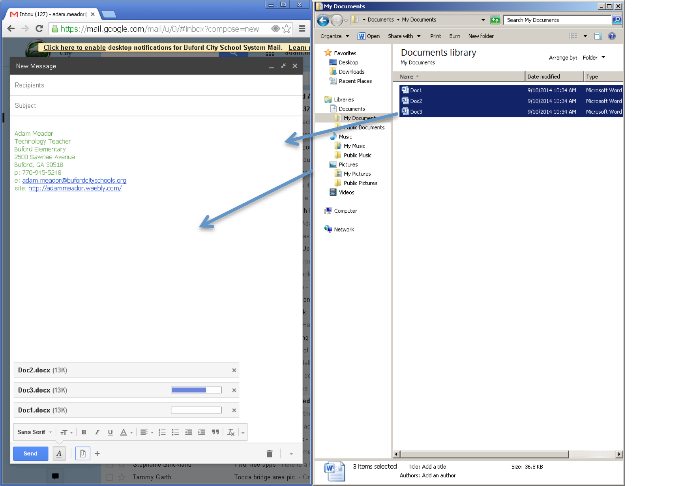
Drag & Drop
Attachments

Slide 12
Gmail Keyboard Shortcuts

Slide 13
Extra Credit: Gmail Search Strings
from:
has:attachment
in:anywhere
is:unread

