Slide 1
Understanding Raz-Kids And Why We Need It Now
Adam Meador
KSU ITEC 7445
Emerging Technology

Slide 2
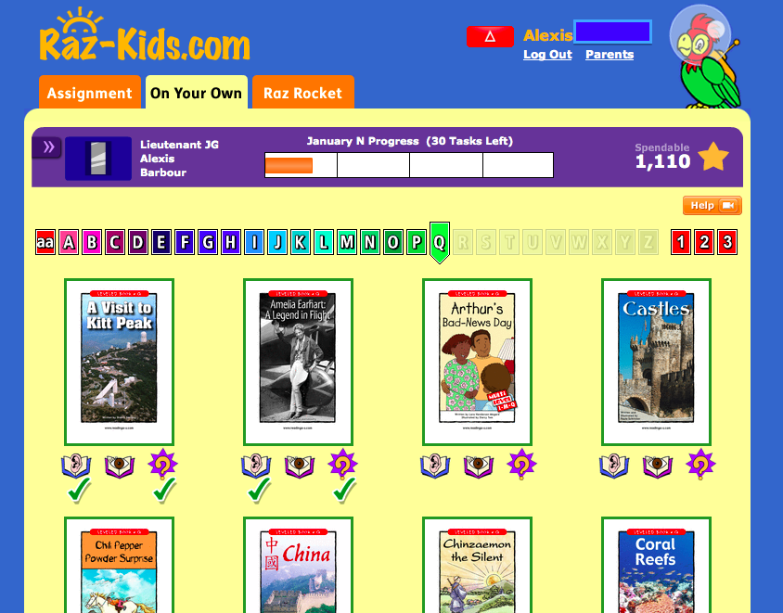
What is Raz-Kids?
Raz-Kids is a supplement to Learning A-Z and a dynamic website with embedded text to speech technologies and assessment tools where kids practice reading ebooks, anytime, anywhere.

Slide 3
Vision and BCSS
How does Raz-Kids support the vision for technology use in Buford Elementary?
Raz-Kids could be the piece to close the reading gap on the 15% of our student population who aren’t reading at grade level.
Raz-Kids is a multi-platform solution that can be utilized with BCSS BYOD, our existing technology, and would complement any future plans to go 1:1 with mobile iOS devices.

Slide 4
Raz-Kids Levels
Raz-Kids supports K-5 reading / Ages 4-11.
Raz-Kids’ leveling criteria are designed to accurately and reliably measure text complexity to support differentiated instruction.
The leveling system follows the guidelines for determining text complexity as outlined in the Common Core State Standards (CCSS). The Standards call for an evaluation of student reading materials in three areas of text complexity: qualitative measures, quantitative measures, and reader and task considerations.

Slide 5
Raz-Kids’ leveling criteria take into account the following qualitative measures:
Predictability of text
Text structure and organization
Logical nature of organization
Text and feature distractions
Labeling and reader supports
Illustration support
Infographics
Complexity
Text reliance on Knowledge demands
Concept load
Familiarity of topic (common everyday vs. unfamiliar)
Single vs. multi-themed
Intertextual dependence

Slide 6
Raz-Kids’ leveling criteria take into account the following quantitative measures:
Total word count
Number of different words
Ratio of different words to total words
Number of high frequency words
Ratio of high frequency words to total words
Number of low frequency words
Ratio of low frequency words to total words
Sentence length
Sentence complexity

Slide 7
Raz-Kids’ leveling criteria:
Consideration of the reader and the reading task is the final component of text complexity as outlined in the Common Core Standards.
Each reader brings different skills, background, and motivation to the act of reading.
Reader and task considerations are something teachers must evaluate for themselves.
Fortunately, because the Raz-Kids leveling system evaluates the qualitative and quantitative criteria accurately and reliably, teachers are freed up to focus their energy and attention where they are most needed – on the reader and task considerations that affect their individual students.

Slide 8
Needed to Implement
Raz-Kids is a supplemental piece to the Learning A-Z products we currently use.
10 Classroom Licenses for 1st Grade at 36 students per class. 360 seats total. Eligible for discounted rate when purchasing 10+ classrooms.
Total cost to implement: 1869.35.
IT Support to download Raz-Kids app to all iOS mobile devices at Buford Elementary.
Student Information Data from Power School for CSV import and initial student and teacher account set up.

Slide 9
Support Needs for BES
Optional or Mandatory Professional Learning needed for teachers to effectively implement the product. Administration could offer two to three optional morning sessions this August as an introduction and follow-up on the product.
IT Support Specialist will need to load iOS app on all BES iOS devices.
All Xirrus Wireless Arrays need to be installed to appropriately handle the Wi-Fi needs generated by the use of this product on mobile devices.
Recorded Webinar Sessions available for free.

Slide 10
Limitations and Concerns
The Raz-Kids Terms of Service state that: If a registered classroom teacher shares a password or produces materials for a non-registered classroom, the entire license will be immediately canceled without refund. Additionally, unauthorized use is subject to retroactive charge.
Concern: Implementation is for 1st grade only. It must be abundantly clear to 1st grade teachers to not share Raz-Kids products with the K teachers as this could void the school license agreement.

Slide 11
Potential Funding Sources
Total cost to implement: 1869.35 for 360 1st grade seats.
Funding Options – General Funds, Title Funds, PTO Local Fund, Central Office Funds

Slide 12
Raz-Kids in the Classroom
Leveled ebooks for independent reading.
Custom and self-paced assignments according to student’s level.
“Listen” ebooks having engaging animation and sound effects.
“Read” ebooks allow students to record their reading for teacher fluency progress checks.

Slide 13
Raz-Kids in the Classroom
“Listen” ebooks have built in text-to speech technology that reads the story aloud and highlights spoken words as they are read.

Slide 14
Raz-Kids in the Classroom
Students can access Raz-Kids through our iOS products.
Students can access through netbooks and desktops.
Students can easily access through BYOD. The Raz-Kids app is also Android compatible.

Slide 15
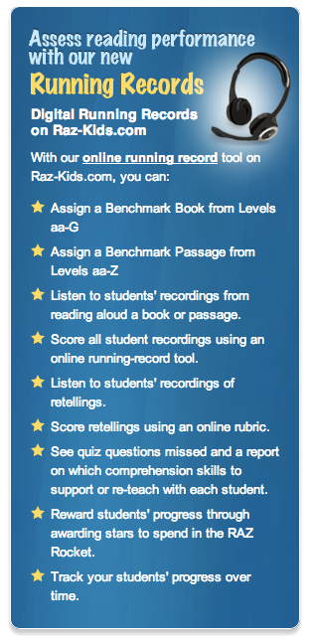
Raz-Kids in the Classroom
2 non-fiction and 2 fiction benchmark passages for every reading level.
Assign benchmark passages to students and review student recordings of their reading.

Slide 16
About Running Records
Running Records are one part of a three-part process to place students in instructionally appropriate level texts and determine whether or not students are ready to move up a level.
Part 1: Students read Benchmark Passages or Benchmark Books, and you capture their reading behavior on Running Records.
Part 2: Students retell the text, and you use Retelling Rubrics to score their comprehension.
Part 3: Students take an oral or written Comprehension Quick Check Quiz, and each question's answer tells what skill it assessed to help you identify comprehension skills for additional practice.
Communication and Collaboration

Slide 17
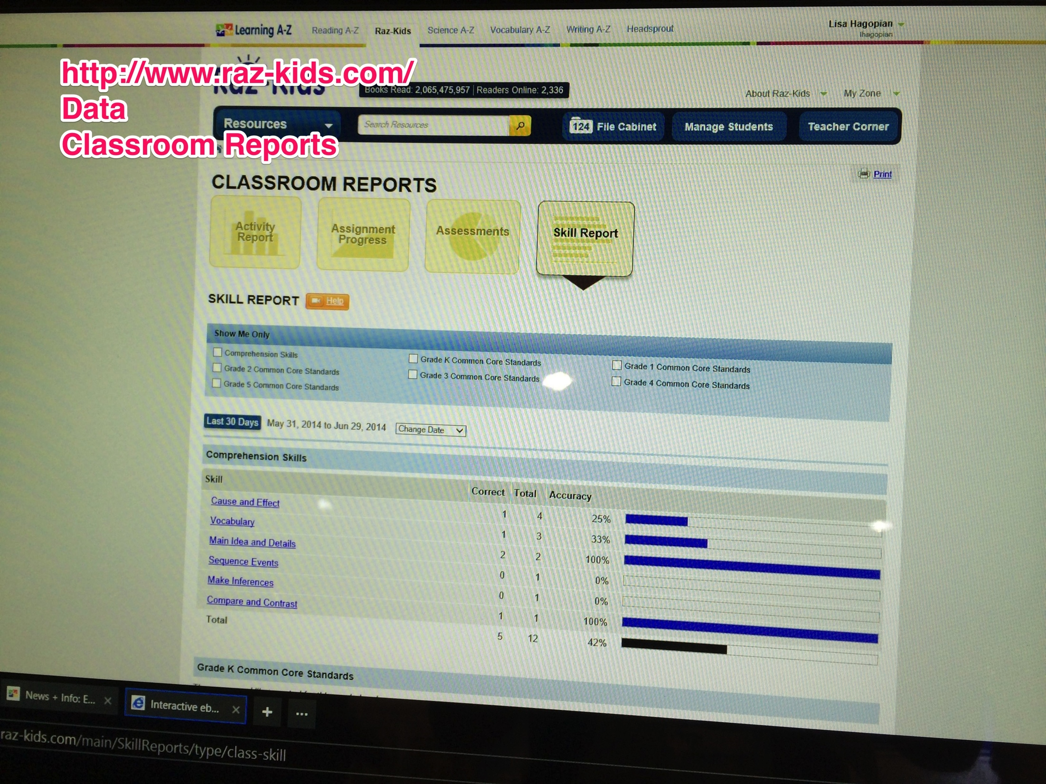
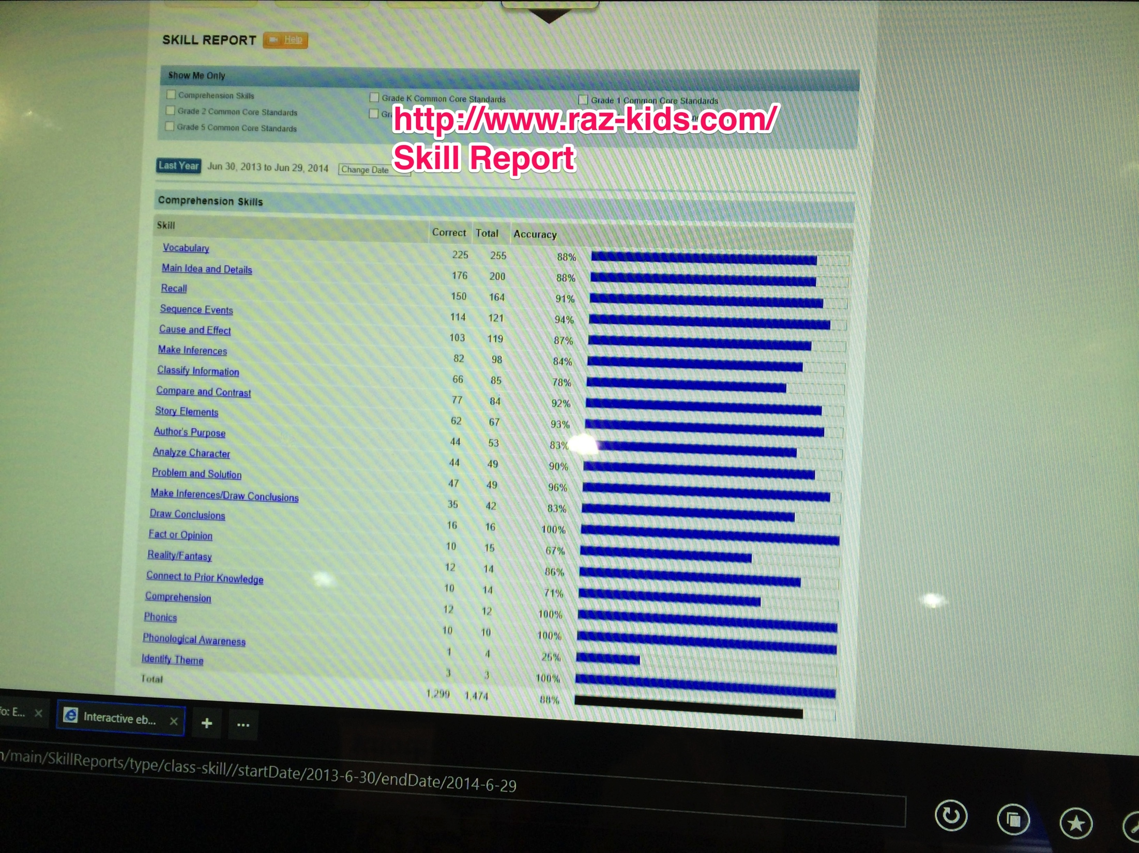
Data Component
Access Classroom Reports and Skill Reports

Slide 18
Why do we need Raz-Kids in the classroom?
This technology will help close the reading gap on our lowest 15%.
Raz-Kids is aligned with Common Core Standards.
With over 27 different built in reading levels this product will meet a diverse set of needs and generate differentiation quickly and effectively.
Promotes parent involvement through the Parent Access Roster component. Parents can monitor their child’s progress easily.
An affordable option for differentiated instructional resources.

Slide 19
How do other educators evaluate the performance of Raz-Kids?
“Our K and 1 teachers have been using Raz-Kids for several years now as part of their guided reading program. The students love reading online and taking tests. The program is so motivational for all children.” Leslie Mulkey, Literacy Facilitator K–5, Fouke Elementary School, New York
“In a world of data, assessment, and data-driven instruction, anything that can give me information on my students' progress is a huge perk in my eyes. … One of the neat features Raz-Kids has is the ability to look at many different reports about your students on the site. Any program that can lay out that kind of information for me quickly and effortlessly is one I adore.” Mrs. Wagers, 1st Grade Teacher, Ohio

Slide 20
Research available on the effectiveness of Raz-Kids
An in depth look at the research behind and importance of differentiated reading instruction can be found in the Raz-Kids White Paper written by Adria F. Klein, Ph.D at:http://www.raz-kids.com/main/Download/id/white_paper_raz-kids/resource/teachercorner

Slide 21
Implementation Plan
2014-2015 Student Data needs to be in place within Power School before Raz-Kids CSV import.
Optional or Mandatory Professional Learning needed for 1st grade teachers to correctly implement.
Live Webinars and also recorded Webinars are available to use for free.
Proper set up of iOS app on all BES iOS devices.
Additional microphone headsets may need to be purchased.
Proper Xirrus Wi-Fi Infrastructure in place.

Slide 22
Reflection
Initially I didn’t understand the scope of Raz-Kids. I was aware of the website. I also was aware of the fact that my faculty used Learning A-Z printables with some frequency. I set out at the ISTE 2014 conference to evaluate the companion piece to Learning A-Z called Raz-Kids. In speaking with the Learning A-Z representative at ISTE it became abundantly clear that this was a solution that we needed in place at Buford Elementary. Investigating and interacting with the representative at ISTE as well as preparing this presentation gave me valuable insight into what can be expected of a effective technology facilitator and leader.

Slide 23
References
Klein, Ph.D, A. (n.d.). Providing Differentiated Reading Instruction to Meet the Individual Needs of Students. Learning A-Z.
Learning A-Z. (n.d.). Interactive ebooks for children | Raz-Kids. Retrieved July 11, 2014, from http://www.raz-kids.com/

